Slide 1
Beneath the abstraction

Slide 2
Index
Relate the continuous to discrete
Logic Level and Noise Margins
Calculate Noise Margins
DC Transfer Characteristics
The Static Discipline
Logic families
Transistor
Moore Law
Semiconductors
Diode
MOS Transistors
nMOS, pMOS and CMOS
Switch models of MOS
CMOS gates
Transmission Gates

Slide 3
Relate the continuous to discrete
A digital system uses discrete-valued variables
However, the variables are represented by continuous physical quantities
the voltage on a wire, the position of a gear, or the level of fluid in a cylinder
The designer must choose a way to relate the continuous value to the discrete value.
Consider representing a binary signal A with a voltage on a wire
let 0 volts (V) indicate A=0 and 5V indicate A=1
any real system must tolerate some noise, so 4.97V probably can to be interpreted as A=1 as well
but what about 4.3V? Or 2.8V? Or 2.5V?

Slide 4
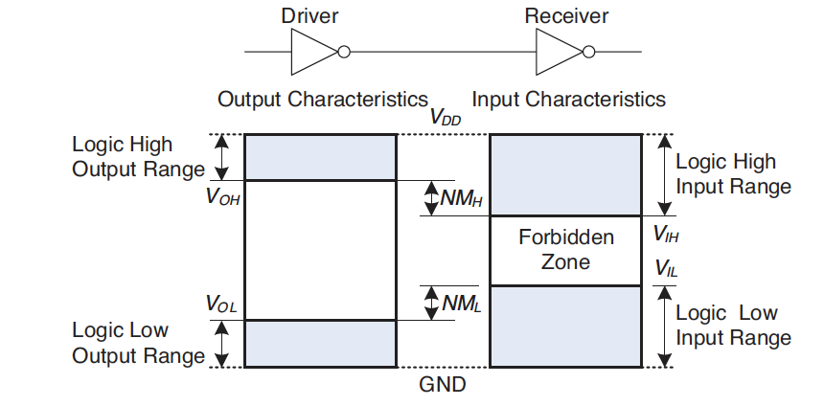
Logic Level and Noise Margins
The lowest voltage is 0V, also called ground or GND, the highest voltage comes from the power supply and is called VDD
The mapping is done by defining logic levels
V_{OL}, V_{OH}, V_{IL}, V_{IH}
The noise margins are the amount of noise that could be added to an output such that the signal can still be interpreted as a valid input
NM_{L} = V_{IL} – V_{OL}, NM_{H} = V_{OH} – V_{IH}

Slide 5
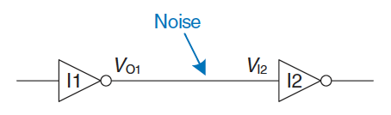
Calculate Noise Margins
Consider the following circuit:
V_{O1} is the output voltage of inverter I₁
V_{I2} is the input voltage of inverter I₂
Both inverters have the following characteristics
V_{DD}=5V, V_{IL}=1.35V, V_{IH}=3.15V, V_{OL}=0.33V, V_{OH}=3.84V
What are the inverter low and high noise margins?
NM_{L} = V_{IL} – V_{OL} = 1.35V − 0.33V = 1.02V
NM_{H} = V_{OH} − V_{IH} = 3.84V − 3.15V = 0.69V
Can the circuit tolerate 1V of noise between V_{O1} and V_{I2}?
it can tolerate the noise when the output is LOW (NM_{L} = 1.02 V)
but not when the output is HIGH (NM_{H} = 0.69V)

Slide 6
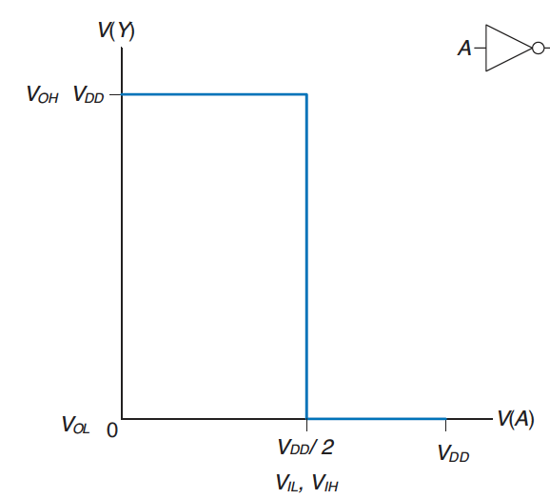
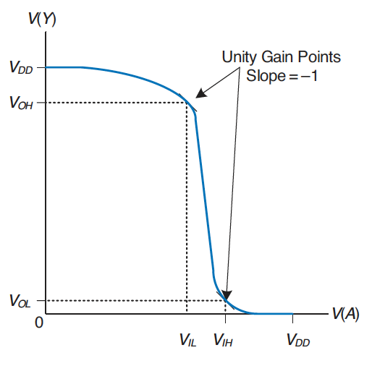
DC Transfer Characteristics
To understand the limits of the digital abstraction, we must delve into the analog behaviour of a gate
The DC transfer characteristics describe the output voltage as a function of the input voltage when the input is changed slowly enough that the output can keep up
An ideal inverter would have an abrupt switching threshold at V_{DD}/2
for V(A) < V_{DD}/2, V(Y) = V_{DD}; for V(A) > V_{DD}/2, V(Y) = 0
V_{IH} = V_{IL} = V_{DD}/2. V_{OH} = V_{DD} and V_{OL} = 0
A real inverter changes more gradually
when V(A) is 0, the output voltage V(Y) = V_{DD}
when V(A) = V_{DD}, V(Y) = 0
but the transition is smooth and may not be cantered at V_{DD}/2
This raises the question of how to define the logic levels?
where the slope of the transfer characteristic dV(Y)/dV(A) is −1 (unity gain points)
usually maximizes the noise margins

Slide 7
The Static Discipline
The static discipline requires that given logically valid inputs, every circuit element will produce logically valid outputs
sacrifice the freedom of using arbitrary analog circuit elements
provides simplicity and robustness
raise the level of abstraction from analog to digital, increasing design productivity by hiding needless detail
The choice of V_{DD} and logic levels is arbitrary, but all gates that communicate must have compatible logic levels
gates are grouped into logic families
gates in a logic family obey the static discipline when used with other gates in the same family
logic gates in the same logic family snap together like Legos in that they use consistent power supply voltages and logic levels

Slide 8
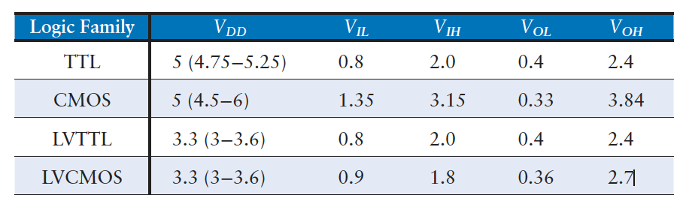
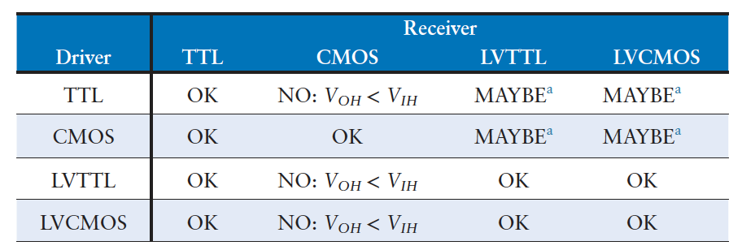
Logic families
Four major logic families predominated from the 1970’s through the 1990’s:
Transistor-Transistor Logic (TTL)
Complementary Metal-Oxide-Semiconductor Logic (CMOS)
Low Voltage TTL Logic (LVTTL)
Low Voltage CMOS Logic (LVCMOS)
Since then, a proliferation of even lower power supply voltages appeared

Slide 9
Transistor
Babbage’s Analytical Engine was built from gears
Early electrical computers used relays or vacuum tubes
Modern digital systems use transistors
electrically controlled switches that turn ON or OFF when a voltage or current is applied to a control terminal
cheap, small, and reliable
The two main types of transistors:
bipolar junction transistors (BJT)
metal-oxide-semiconductor field effect transistors (MOSFETs or MOS)
History:
1958, Jack Kilby at Texas Instruments built the first integrated circuit
1959: Robert Noyce at Fairchild Semiconductor patented a method for interconnecting multiple transistors on a single silicon chip
at the time, transistors cost about $10 each; after three decades of advances, we can pack roughly one billion MOS onto a 1 cm² chip of silicon, and each transistor cost less than 10 micro-cents
MOS are now the building blocks of almost all digital systems

Slide 10
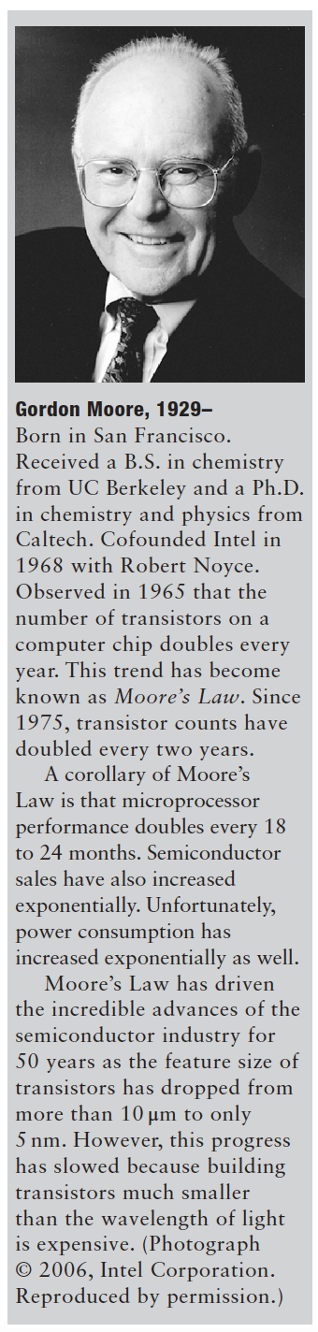
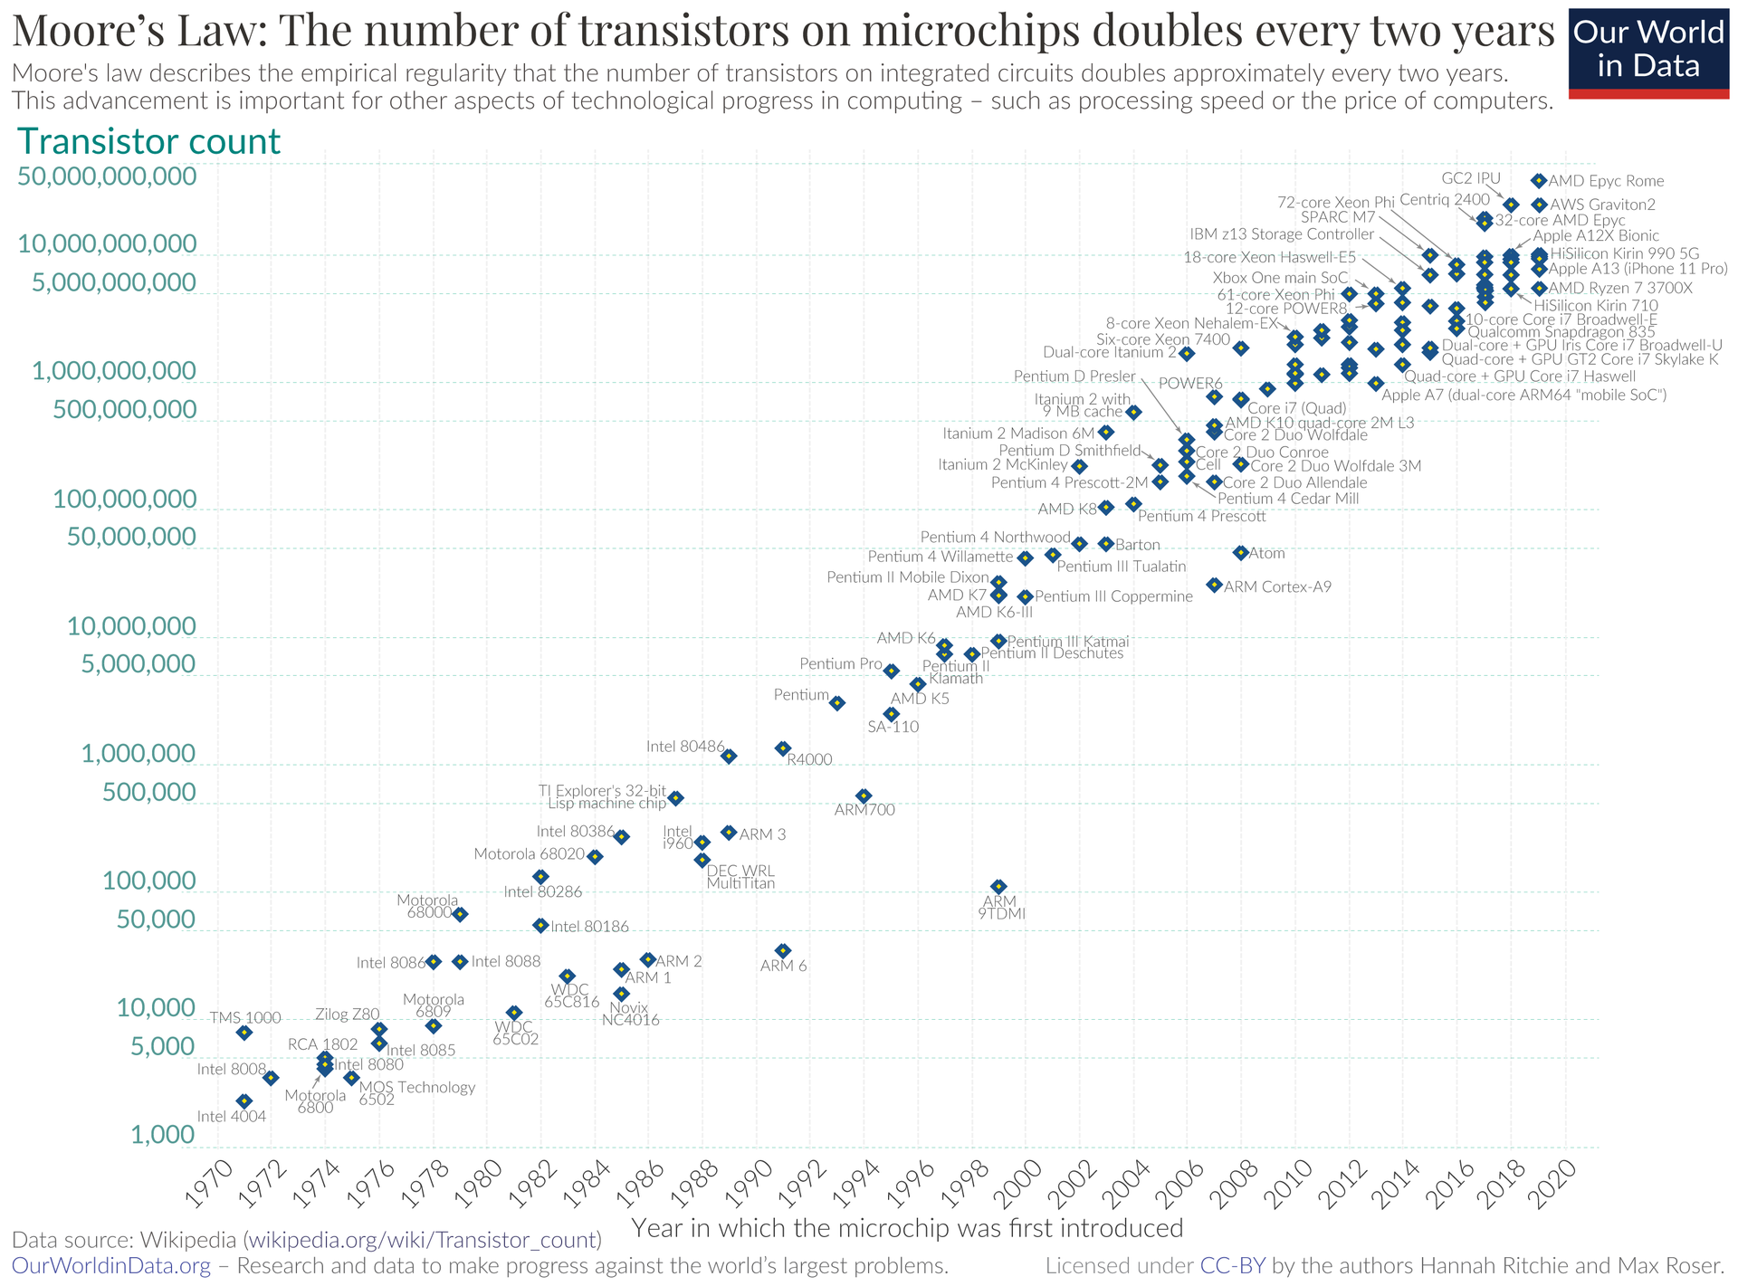
Moore Law

Slide 11
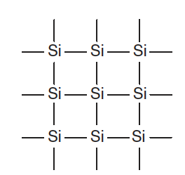
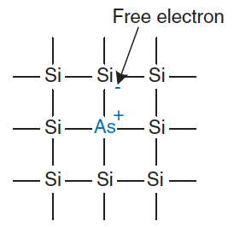
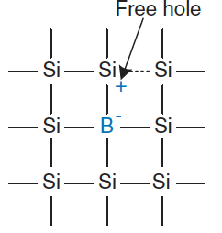
Semiconductors
MOS are built from Silicon (Si)
four electrons in its valence and forms bonds with four adjacent atoms, resulting in a crystalline lattice
A poor conductor: all the electrons are tied up in covalent bonds
Becomes a better conductor if small amounts of impurities (dopant) are added
A dopant like arsenic (As) has an extra electron that is not involved in the bonds
that electron can move carrying a negative charge
n-type dopant
A dopant like boron (B) miss an electron (hole)
an electron from a neighbour atom can move to fill the missing bond, and leaving a hole: it seems the hole can migrate around the lattice
the hole is a lack of negative charge, so it acts like a positively charged particle: p-type dopant
Because the conductivity of silicon changes over many orders of magnitude depending on the concentration of dopants, silicon is called a semiconductor

Slide 12
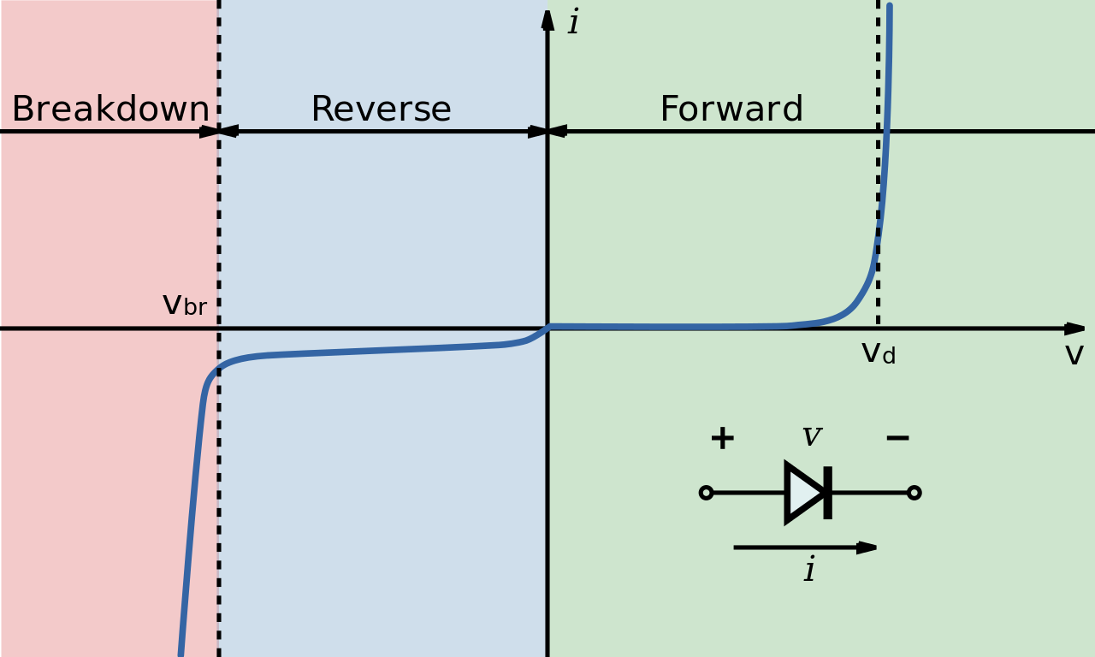
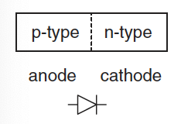
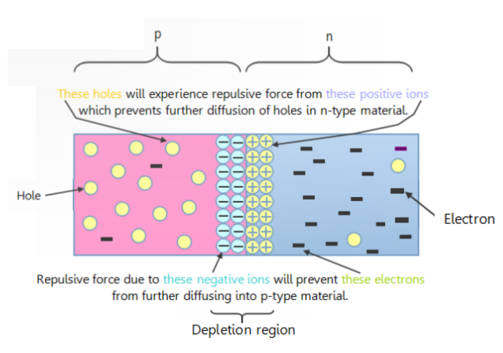
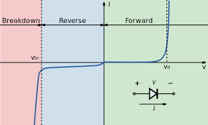
Diode
The junction between p-type and n-type silicon is called a diode
p-type region is called the anode
n-type region is called the cathode
At this junction we get a depletion region
free electrons in the n-type side near the junction begin to diffuse across the junction and fall into holes near the junction in the p-type side
this migration form a barrier potential and prevents more electrons from moving across
We can apply a voltage:
when the voltage on the anode rises above the voltage on the cathode, the diode is forward biased, and current flows
when the anode voltage is lower than the voltage on the cathode, the diode is reverse biased, and no current flows

Slide 13
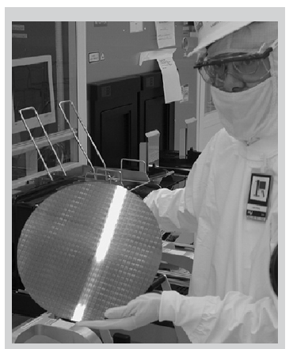
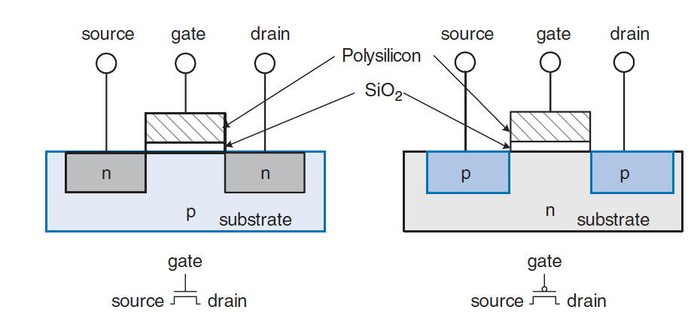
MOS Transistors
A MOS is a sandwich of several layers of conducting and insulating materials
it is built on thin, flat wafers of silicon of about 30cm
transistors are a fraction of a micron in length, so it is inexpensive to manufacture billions of transistors at a time
then, the wafer is cut into rectangles called chips that contain thousands, millions, or even billions of transistors
The sandwich consists of a conducting layer (gate) on top of an insulating layer of silicon dioxide (SiO₂) on top of the silicon substrate
There are two flavours of MOS:
nMOS has regions of n-type dopants adjacent to the gate called source and drain and are built on a p-type substrate
pMOS are just the opposite
MOS behaves as a voltage-controlled switch in which the gate voltage creates an electric field that turns ON or OFF a connection between the source and drain

Slide 14
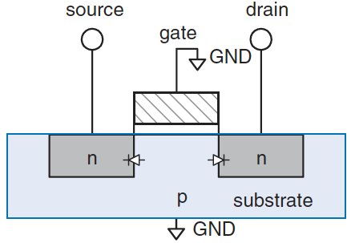
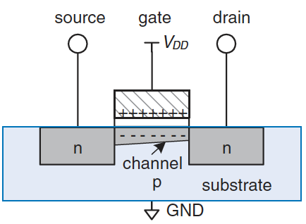
nMOS
The substrate is tied to GND
When the gate is at 0V, the diodes between source/drain and substrate are reverse biased
there is no path for current to flow between source and drain
the transistor is OFF
When the gate is raised to VDD, it establishes an electric field that attracts positive charge on the top and negative charge to the bottom
if the voltage is sufficiently large (threshold voltage), that region inverts from p-type to n-type (channel)
now the transistor has a continuous path from the source through the channel to the drain, so electrons can flow
the transistor is ON

Slide 15
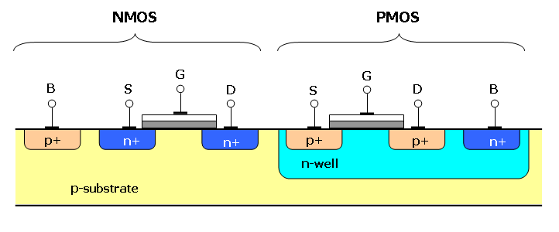
pMOS and CMOS
pMOS works in just the opposite fashion
the substrate is tied to V_{DD}
when the gate is also at V_{DD}, the pMOS is OFF
when the gate is at GND, the channel inverts to p-type and the transistor is ON
nMOS need a p-type substrate, and pMOS need an n-type substrate, to build both flavours of transistors on the same chip, manufacturing processes start with a p-type wafer, then implant n-type regions (well)
complementary MOS or CMOS
CMOS processes are used to build the vast majority of all transistors fabricated today

Slide 16
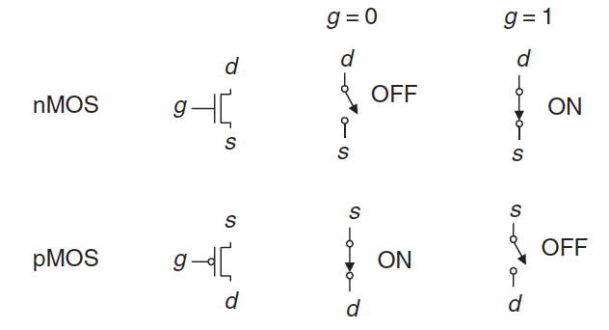
Switch models of MOS
In summary, CMOS processes give us two types of electrically controlled switches
The voltage at the gate regulates the flow of current between the source and drain
nMOS are OFF when the gate is 0 and ON when the gate is 1
pMOS are just the opposite: ON when the gate is 0 and OFF when the gate is 1

Slide 17
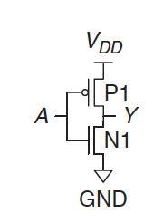
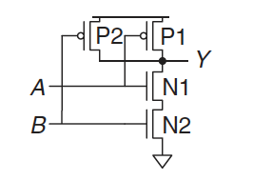
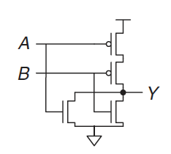
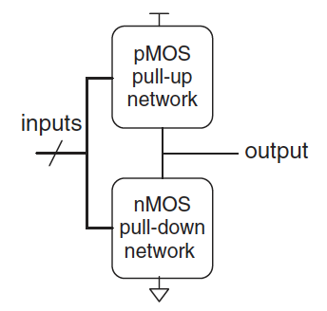
CMOS gates
NOT gate:
if A=0, N1 is OFF and P1 is ON, hence Y is connected to VDD but not to GND and it is pulled up to a logic 1
if A=1, N1 is ON and P1 is OFF, and Y is pulled down to a logic 0
NAND gate:
nMOS N1 and N2 are connected in series; both transistors must be ON to pull the output down to GND
pMOS P1 and P2 are in parallel; only one transistor must be ON to pull the output up to V_{DD}
NOR gate:
the nMOS transistors should be in parallel
the pMOS transistors must be in series
General form of inverting logic (NOT, NAND, NOR):
transistors are in parallel: ON if either transistor is ON
transistors are in series: ON only if all transistors are ON

Slide 18
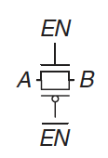
Transmission Gates
Unfortunately, MOS are not perfect switches
nMOS transistors pass 0 well, but pass 1 poorly
pMOS transistors pass 1 well, but 0 poorly
It can be convenient to use an ideal switch that can pass both 0 and 1 well
the parallel combination of the two passes both values well
When EN=0 and EN=1, both transistors are OFF, the transmission gate is OFF, so A and B are not connected
When EN=1 and EN=0, the transmission gate is ON and any logic value can flow between A and B

Slide 19
Power consumption
The amount of energy used per unit time
Battery life of portable systems
a smartphone battery holds about 10 W-hr of energy, meaning that it could deliver 1W for 10 hours or 2W for 5 hours, and so forth
for your phone to last a full day, its average consumption should be under 1W
laptops typically have 50 to 100 W-hr batteries and consume under 10W in normal operation, of which the screen is a large fraction
Power is also significant for plugged systems
electricity costs money and emissions
the system will overheat if it draws too much power
Digital systems draw both dynamic and static power
dynamic: power used as signals change between 0 and 1
static: power used even when signals do not change and the system is idle

Slide 20
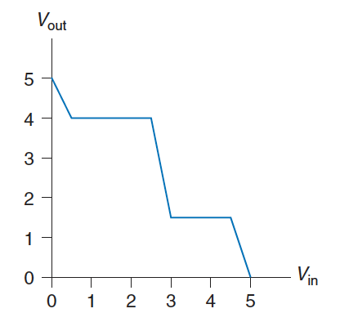
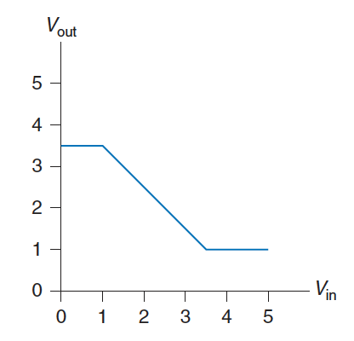
Exercises (1)
Ex4.1: Is it possible to assign logic levels so that a device with the transfer characteristics shown in figures would serve as an inverter? If so, what are the input and output low and high levels (V_{IL}, V_{OL}, V_{IH}, and V_{OH}) and noise margins (NM_{L} and NM_{H})? If not, explain why not.
(a) (b)
Solution:
(a) V_{IL}=2.5V; V_{IH}=3V; V_{OL}=1.5V; V_{OH}=4V; NML=1V; NM_{H}=1V
(b) No, there is no legal set of logic levels. The slope of the transfer characteristic never is better than -1, so the system never has any gain to compensate for noise

Slide 21
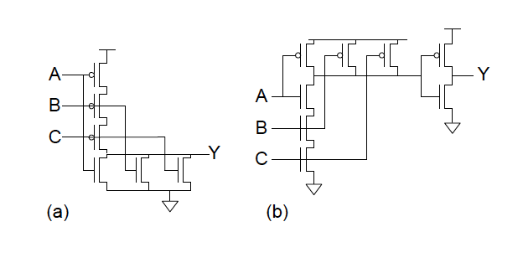
Exercises (2)
Ex4.2: Sketch a transistor-level circuit for the following CMOS gates: (a) three-input NOR gate; (b) three-input AND gate
Solution:

